Slide 1
Upward Spirals of State Gratitude and Positive Affect in Daily Life: an Ecological Assessment Study Using the Experience Sampling Method
drs. Lilian Jans-Beken
prof. dr. Nele Jacobs, dr. Mayke Janssens, dr. Sanne Peeters,
dr. Jennifer Reijnders, prof. dr. Lilian Lechner, dr. Johan Lataster

Slide 2
Positive Affect
Broaden
Build
Positive Affect
Broaden and Build Theory
of Positive Emotions
Notes:
This study was based on the premises of the Broaden and Build Theory of Positive Emotions of Barbara Fredrickson (2001). This theory states that positive affect broadens one’s attention span instead of the narrowing of one’s attention when experiencing negative emotions. This openness to the surroundings enables us to build our resources for the future such as a cognitive map and social ties or personal strengths such as optimism and resilience. Gratitude for instance encourages individuals to act in a prosocial way towards the benefactor and others, it evokes creativity regarding reciprocal actions that can promote the well-being of others, and it helps forming relationships and it provides a feeling of being loved and cared for. Gratitude seems to be able to build resources on the personal, social and societal level. This theory also posits an upward spiral of positive emotions; positive emotions lead to new positive emotions. This upward spiral has been found between gratitude and positive affect on the level of days, weeks and months. Our study looked into the existence of this upward spiral on the micro-level of everyday and if this upward spiral is dependent on levels op positive mental health or psychopathological symptoms.

Slide 3
Experience Sampling Method
7 consecutive days
10 beeps a day
Notes:
RealLife Exp app from lifedatacorp.com

Slide 4
Momentary Positive Affect
Momentary Negative Affect
State Gratitude
Positive Mental Health
Psychopathological symptoms
Notes:
Positive affect: cheerful, happy, satisfied
Negative affect: insecure, anxious, guilty and down
State gratitude: I feel grateful
All measures on a 7-point Likertscale
Positive Mental Health: Mental Health Continuum – Short Form
Measure with a 6-point Likertscale
Symptom Questionnaire 48
Measure with a 5-point Likertscale

Slide 5
N = 106
M = 39, SD = 15 range 18 – 65
Male / Female
41% / 59%
Beeps N = 2432

Slide 6
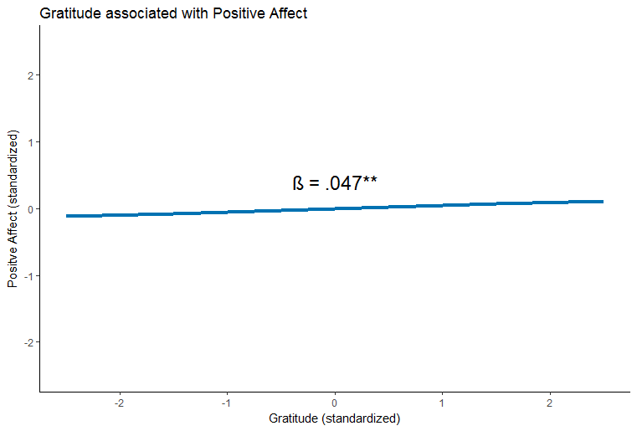
Reciprocal Association Between Gratitude and Positive Affect
Notes:
Multilevel regression analyses with LAG variables, adjusting for negative affect at the previous beep in all analyses and for positive affect at the previous beep and state gratitude at the previous beep respectively. Because of multiple testing the significance level was set at .025. The association between positive affect and gratitude is larger than the association between gratitude and positive affect although both are significant at the .025 level.

Slide 7
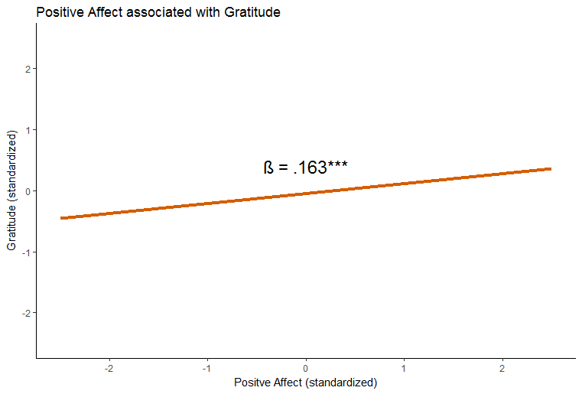
Reciprocal Association Between Positive Affect and Gratitude
Notes:
The association between positive affect and gratitude is larger than the association between gratitude and positive affect although both are significant at the .025 level.

Slide 8
Gratitude * Positive Mental Health → Positive Affect
β = .009, p = n.s.
Gratitude * Psychopathology → Positive Affect
β = -.004, p = n.s.

Slide 9
Positive Affect * Positive Mental Health → Gratitude
β = .042**, p < .0125
Positive Affect * Psychopathology → Gratitude
β = -.046**, p < .0125

Slide 10
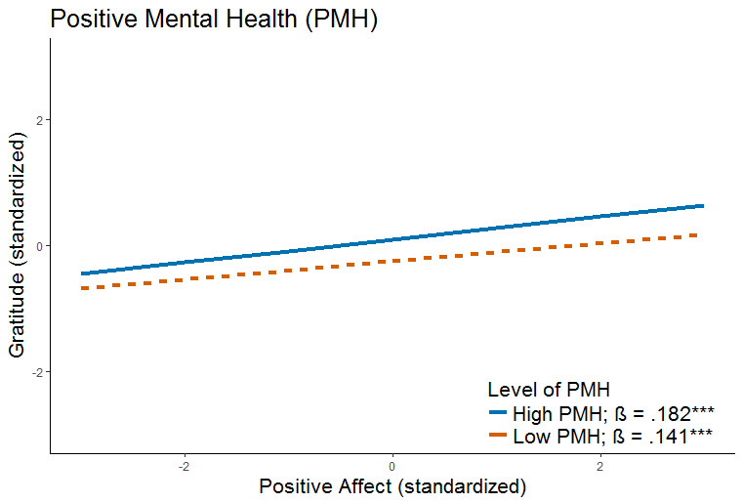
Notes:
Only the interaction analyses of the associations between positive affect and state gratitude were significant at the .0125 level because of multiple testing.
The association between positive affect and state gratitude was larger in individuals with high positive mental health compared to individuals with low positive mental health; both associations were significant.

Slide 11
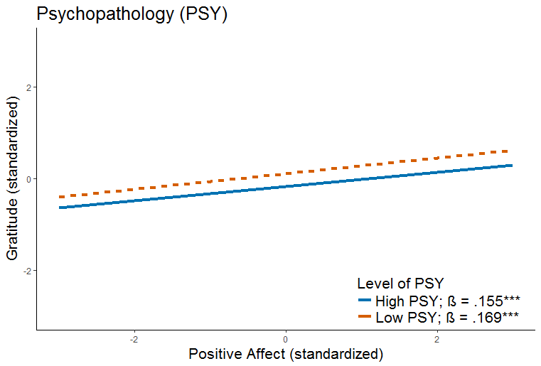
Notes:
The association between positive affect and state gratitude was larger in individuals with low psychopathology compared to individuals with high psychopathology; both associations were significant.

Slide 12
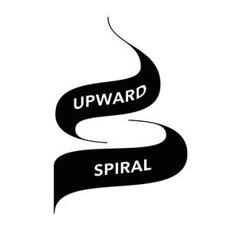
Notes:
There seems to be an upward spiral between state gratitude and positive affect at the everyday microlevel. The association between state gratitude and positive affect is independent of levels op positive mental health or psychopathology. The association between positive affect and state gratitude is dependent on the level of positive mental health and psychopathology.
Individuals with higher positive mental health show a somewhat stronger association between positive affect and state gratitude than individuals with lower positive mental health. This is in line with the broaden-and-build theory as individuals with higher positive mental health might be more open to for benefits in their surroundings and they might respond to these benefits with more gratitude to benefit their personal resources for the future such as valuable relationships.
Something similar can be said about the difference between individuals with high and low psychopathology. Individuals with higher psychopathology might be less perceptive of benefits in their surroundings due to a disruption of their selective attention. This is also consistent with the broaden-and-build theory.

Slide 13
Strengths:
ESM prevents retrospective bias
Limitations:
Selection bias
Subjective self-reporting
Notes:
Strengths: the recency effect, the salience effect, and the mood-congruent memory effect.
Limitation: selection bias due to the theme of the research. This was reflected in the scores: many high positive mental health and little high psychopathology. ESM is ecological valid but still based on subjective self-reporting. Objective measures might be the future

Slide 14
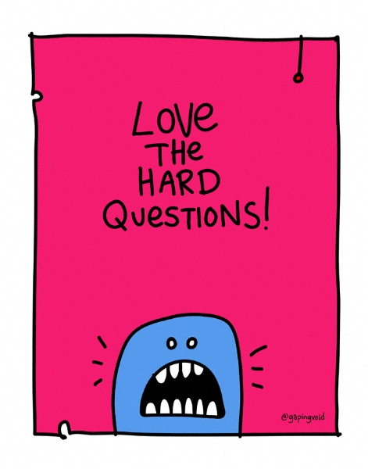
info@lilianjansbeken.nl
@lilianjansbeken
@gapingvoid

Slide 15
References
Carlier, I., Schulte-Van Maaren, Y., Wardenaar, K., Giltay, E., Van Noorden, M., Vergeer, P., & Zitman, F. (2012). Development and validation of the 48-item Symptom Questionnaire (SQ-48) in patients with depressive, anxiety and somatoform disorders. Psychiatry Research, 200(2), 904-910.
Fredrickson, B. L. (2001). The role of positive emotions in positive psychology: The broaden-and-build theory of positive emotions. American Psychologist, 56(3), 218-226. doi:10.1037/0003-066X.56.3.218
Fredrickson, B. L., & Joiner, T. (2002). Positive emotions trigger upward spirals toward emotional well-being. Psychological science, 13(2), 172-175.
Keyes, C. L. (2002). The mental health continuum: From languishing to flourishing in life. Journal of Health and Social Behavior, 43(2), 207-222.
Lamers, S., Westerhof, G. J., Bohlmeijer, E. T., ten Klooster, P. M., & Keyes, C. L. (2011). Evaluating the psychometric properties of the mental health Continuum‐Short Form (MHC‐SF). Journal of Clinical Psychology, 67(1), 99-110.

